Slide 1
Pranamika : Common man reviews and rates.
PIP2001 Capstone Project
Review-1
Batch Number: CIT-G 30
Under the Supervision of,
Mr. SAKTHIVEL E.
Professor / Associate Professor / Assistant Professor
School of Computer Science and Engineering
Presidency University
Roll Number | Student Name
2011CIT0121 | AMAL V
20211CIT0095 | SHAIK MD ASIM
20211CIT0085 | BURHAN PASHA
20211CIT0163 | Y LAKSHMI SWAROOP
Name of the Program: B-TECH
Name of the HoD: Dr. ANANDA RAJ S P
Name of the Program Project Coordinator: Dr. Sharmasth Vali Y
Name of the School Project Coordinators: Dr. Sampath A K / Dr. Abdul Khadar A / Mr. Md Ziaur Rahman

Slide 2
Introduction
Title:
Pranamika – Common Man Reviews and Rates ls
Subtitle:
A Citizen Accountability Platform
Abstract:
Citizens rely on local government officials to provide essential services and ensure the implementation of various government schemes. However, public servants are often involved in inefficiency, misconduct, or corrupt practices that undermine governance. Pranamika is an Android-based platform that allows citizens to review and rate local government officials based on their interactions. By publicly sharing ratings and reviews, the system promotes accountability and transparency in governance.

Slide 3
Literature Review
Namita Sharma and Rajesh Singh (2022) – "Citizen Feedback Systems: Leveraging Technology for Government Accountability.
"John Taylor and Mick Moore (2021) – "E-Governance and Public Sector Corruption: A Cross-Country Analysis.
"Wei Li and Maria Shapiro (2020) – "Employee Performance Evaluation Systems in Public Administration.
"Deborah Roberts and Simon Fry (2023) – "Trust in Public Administration and its Evaluation: Case Studies.
"Vikram Singh and Manisha Joshi (2021) – "Mobile-Based Rating Systems for Public Services.
"Carlos Rodriguez and Emily Green (2022) – "Impact of Citizen Engagement on Government Efficiency.

Slide 4
Existing method Drawback
Limited Inclusivity and Accessibility
Lack of Trust in Anonymity and Security
Ineffective Moderation and Verification of Feedback
Insufficient Integration with Governance Systems
Limited Scalability and Adaptability
Ethical and Legal Considerations
Inadequate User Engagement and Retention
Insufficient Focus on Real-Time Analytics and Predictive Insights

Slide 5
Proposed Method
Agile Development Process
User-Centered Platform Design
Advanced Technology Integration
Feedback Collection and Management
Enhanced Security Measures
Long-Term Sustainability Strategies
Two-Factor Authentication (2FA)
Rating System

Slide 6
Objectives
Provide a platform for citizens to review and rate local government officials.
Promote transparency and accountability in public administration.
Empower citizens by giving them a voice in evaluating public servants.
Use citizen feedback to encourage improvement in the performance of government officials.
Help reduce corrupt practices by exposing bad behavior publicly.
Enable better communication between citizens and government through feedback and complaint mechanisms.
Combating Corruption and Unethical Practices
Encouraging Data-Driven Governance

Slide 7
Methodology/Modules
User Authentication: Register/Login via OTP
Rating & Review System: Citizens can rate and review officials.
Public Display: Reviews are public and shareable.
Administration: Backend for viewing and managing reports (optional future work).
Complaint Management System: Lodge official complaints against public servants. Track the status of complaints. Provide feedback after resolution.
Review Moderation System: Flag inappropriate reviews. Manual or automated moderation of content. Admin approval for flagged reviews.
React Native (TypeScript) : Cross-Platform Support: React Native enables code reuse across Android and iOS, significantly reducing development time.

Slide 8
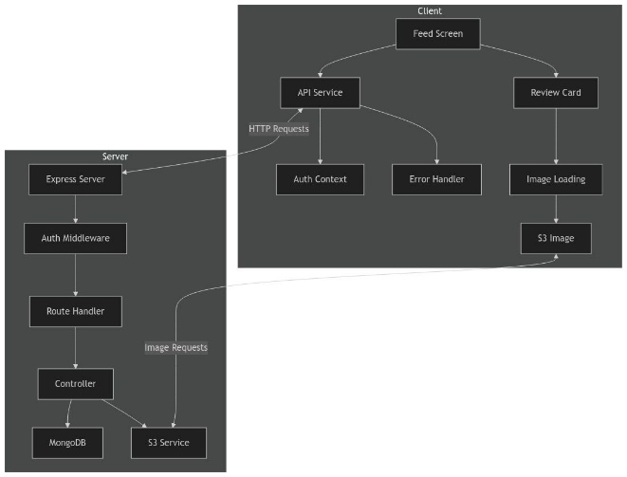
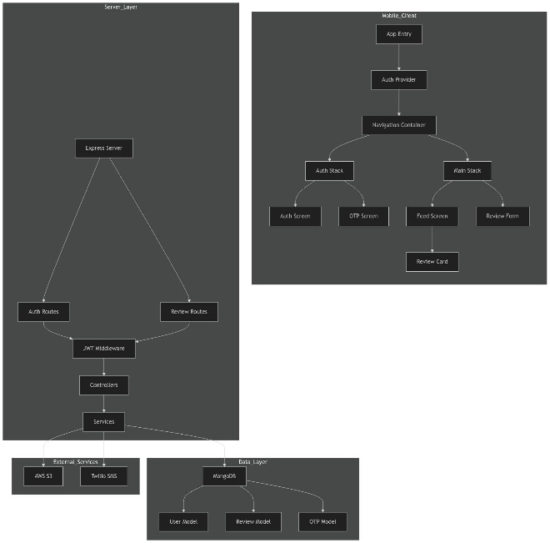
Architecture

Slide 9
Hardware/software components
Hardware:
Android Smartphone (API Level 21+, Minimum 2 GB RAM and 16 GB storage)
Software:
ReactNative(TypeScript)
State Management with React Context API
Axios for HTTP Requests
Node.js with Express
Database: MongoDB
AWS Cloud Services

Slide 10
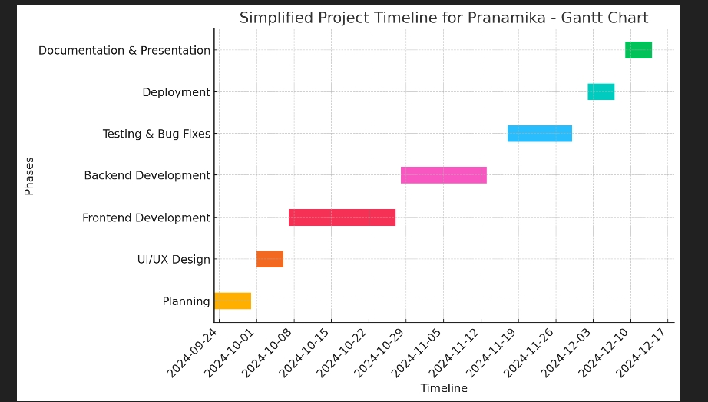
Timeline of Project

Slide 11
Expected Outcomes
Increased Transparency: The platform enables citizens to provide public feedback on the performance of local government officials, promoting transparency in governance.
Accountability of Public Officials: Public officials become more accountable to the community due to visible reviews and ratings, leading to improved behavior and service.
Empowerment of Citizens: Citizens gain a voice in evaluating public officials, encouraging greater participation in local governance and decision-making processes.
Improved Government Services: The system motivates public officials to improve their efficiency and professionalism, ultimately enhancing the quality of government services for citizens.

Slide 12
Conclusion
The Pranamika project is a powerful tool for fostering transparency, accountability, and citizen engagement in local governance. By providing a platform for honest feedback on public officials, it bridges the gap between the government and citizens. This system not only enhances public trust but also drives continuous improvement in government services.
Pranamika ensures that every citizen's voice is heard and contributes to a more transparent, responsive, and efficient public administration. Through technology and civic engagement, it paves the way for a more accountable governance system and encourages better performance from public servants, ultimately benefiting the entire community.
These sections summarize the key achievements and the importance of your project in addressing issues with governance, concluding with the project's impact and value to society.

Slide 13
Github Link
The Github link provided should have public access permission.
Github Link
https://github.com/amalv07

Slide 14
References (IEEE Paper format)
J. Doe, "Public Perception of Local Officials: A Study of Citizen Reviews," Civic Insights, Jan. 20, 2023.
Goran Vojkovic, Tihomir Katulic, “Anti-corruption Measures in the New Croatian Public Administration Office Management Regulation” [IEEE] , 2023
R. Green, "Rating Local Government: Insights from the Ground," Community Voices, Mar. 15, 2023.
T. Brown, "Local Leaders: What the People Say," Twitter, June 10, 2023.

Slide 15
References (IEEE Paper format)
A. Smith et al., "Local Government Accountability: Public Trust and Ratings," Public Policy Review, Aug. 5, 2023.
] L. Martin and K. Brown, “Building trust in e-governance: The role of user feedback,” IEEE Internet Computing, vol. 22, no. 6, pp. 50–58, Nov. 2024
J. Brown and S. Patel, “Real-time feedback systems in public service apps: A case study,” IEEE Access, vol. 11, no. 5, pp. 7654–7665, Feb. 2024
T. Wilson and J. Adams, “Security considerations in egovernance platforms: A review,” IEEE Security & Privacy, vol. 19, no. 1, pp. 34–43, Jan. 2025.

Slide 16
Thank You Page
Thank You

